Slide 1
HOW TO COMMUNICATE EFFECTIVELY IN WRITING
Olena Mazurenko, MD, PhD, Assistant Professor, Indiana University
Sue Babich, DrPH, Associate Dean for Global Health, Indiana University

Slide 2
Agenda
1. Review & Discussion of the “Yang, Y.T. and Silverman, R.D., 2015. Legislative prescriptions for controlling nonmedical vaccine exemptions. JAMA, 313(3), pp.247-248.”
2. Review & Discussion of:
Hobbs, S. et al. 2013. Clinical leadership to improve health outcomes. The Lancet, 382, p. 1483
Lafranconi, A. et al. 2015. Medical leadership—from inspiration to education. The Lancet, 386(10003), pp.1531-1532.
Best strategies for effective writing
Potential outlets for your written work

Slide 3
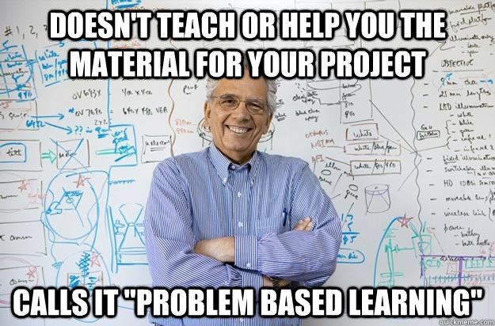
Notes:
I am not sure how other sections will be approached, but I thought we could joke about the fact that we will be learning together through active learning, rather than us giving them all the answers right away. PBL is very uncommon in Ukraine and former USSR

Slide 4
Paper #1
Read the paper
Discuss the following questions:
What are the key points in this paper?
What did you like about this paper? Why?
What could have been improved? Why does it matter?
Why did JAMA accept this paper?

Slide 5
Paper #2
Read the paper
Discuss the following questions:
What are the key points in this paper?
What did you like about this paper? Why?
What could have been improved? Why does it matter?
Why did Lancet accept this paper?

Slide 6
Paper #3
Read the paper
Discuss the following questions:
What are the key points in this paper?
What did you like about this paper? Why?
What could have been improved? Why does it matter?
Why did Lancet accept this paper?

Slide 7
Strategies for Effective Writing

Slide 8
• Think about your
responsibilities
• Remember your
reader has lots of
content to read

Slide 10
Starting your Document
1. Get right to the point
•
Be focused
2. Make reading the material easy
• Be clear, efficient and enjoyable
• Avoid overly formal language
3. Think about your audience
• Tailor your message appropriately

Slide 11
Point of View
• Use the Reader’s
Point of View
• Say something
valuable
• Judge clarity

Slide 12
Language
• Avoid nonstandard vocabulary and
colloquialisms
• Do not end sentences
with “at”
• Use Active voice

Slide 13
Avoid Acronyms

Slide 15
A Few General Rules
1. Don’t use multiple words when you can
use one
2. Stick to idiomatic English
3. Don’t drop articles
4. Remove words that aren’t
performing a real function

Slide 16
Potential Outlets for Your Written Work
With Sue Babich

Slide 17
Sample journals
Public Health Reviews
The Lancet
The Lancet Global Health
Journal of Public Health Management and Practice
JAMA
Others … ?

Slide 18
Strategies for getting started
Assemble a writing team: You and one or more others
Submit abstracts for professional association oral sessions
Draft an outline; agree on timeline and division of labor
Papers, book chapters, monographs, position papers
Recycle, expand, update, comment …

Slide 19
Other considerations
Peer reviewed vs everything else
Writing for the general public:
Magazines
Books
Newspapers
Blogs

Slide 20
Discussion

