Slide 1
a Program of the
American Austrian Foundation
Notes:
1

Slide 2
Mission Statement
IMPROVE
Healthcare in Countries in Transition
PROMOTE
Brain Gain and Prevent Brain Drain
State-of-the-art Postgraduate
Medical Education and Training
PROVIDE
EMPOWER
Healthcare Professionals
REBUILD
The Healthcare Pyramid
Medical Education Beyond Borders
American Austrian Foundation © 2015
Notes:
2

Slide 3
HISTORY
Problem
Healthcare systems in Central & Eastern Europe and the Newly Independent States near collapse after breakdown of the Soviet Union
Top down hierarchy with little opportunity for young doctors to advance
Large exodus of Eastern European doctors to Western Europe and the US
Similar conditions exist today in other countries in transition
American Austrian Foundation © 2015
Notes:
3

Slide 4
HISTORY
Solution
High-level, and highly-specialized medical educational programs for mid-career level, English speaking physicians
Instead of long-term fellowships only short-term programs with multiple opportunities & long term mentoring
Several leading U.S. & E.U. medical institutions committed to support programs – Physicians donate their time & expertise
Austrian Government, OSF and other NGOs and medical community agree to fund and host program
American Austrian Foundation © 2015
Notes:
4

Slide 5
HISTORY
Founding Institutions
Goal: prevent Brain Drain – promote Brain Gain
American Austrian Foundation © 2015
Notes:
5

Slide 6
Three-Step Approach to Capacity Building
STEP 3
Symposia, e-learning,
Open Medical Clubs
Capacity
Building
STEP 2
Experience
Exchange
Clinical and Research Observerships
STEP 1
Knowledge
Transfer
Salzburg Medical Seminars

Slide 7
Knowledge Transfer
STEP 1
OMI Salzburg Medical Seminars
Fellows
one week seminars in Salzburg; 30 to 40 English-speaking mid-career level physicians; Selection based on merit;
Faculty
World-renowned faculty donate their time and expertise
Knowledge Transfer, Networking Opportunities, Lasting Collegial Relationships
… Senior Colleagues Help Junior Colleagues
American Austrian Foundation © 2015
Notes:
7

Slide 8
STEP 1
Academic Partners
American Austrian Foundation © 2015
Notes:
8

Slide 9
STEP 1
OMI Salzburg Medical Seminar Topics
Anesthesiology
Applied Clinical Research
Behavioral Pediatrics &
Child Development (PH)
Bone and Joint Surgery
Cardiac Surgery
Cardiology
Changing the Narrative
on Roma Health (PH)
Dermatology
Diabetes
Diagnostic Imaging
ESU Master Class in Urology
Family Medicine (PH)
General Pediatrics
Infectious Diseases (PH)
Internal Medicine
Palliative Care (PH)
Law and Health (PH)
Lipid Metabolism
Maternal & Infant Health (PH)
Medical Education
Neonatology
Neurology
Neurosurgery
OB/GYN
Oncology A: Hematologic Malignancies
Oncology B: Soft Tissue, Bone, and Skin Malignancies
Ophthalmology
Otolaryngology
Pathology
Pediatric Cardiology
Pediatric Radiology
Pediatric Urology
Psychiatry
Rehabilitation Medicine (PH)
Temporal Bone Surgery
Transgender (PH)
Trauma & Emergency Surgery
American Austrian Foundation © 2015

Slide 10
OMI Seminar Fellowships by Country
1993–2015
STEP 1
Central &
Eastern Europe
Albania, Belarus, Bosnia & Herzegovina, Bulgaria, Croatia, Czech Republic, Estonia, Hungary, Kosovo, Latvia, Lithuania, Macedonia, Moldova, Montenegro, Poland, Romania, Russia, Serbia, Slovakia, Slovenia, Ukraine
12.211
South Caucasus & Central Asia
3.751
Armenia, Azerbaijan, Georgia, Kazakhstan, Kyrgyzstan, Mongolia, Tajikistan, Turkmenistan, Uzbekistan
Western Europe
554
Austria, Belgium, Cyprus, Denmark, Finland, France, Germany, Greece, Ireland, Italy, Luxembourg, Netherlands, Norway, Portugal, Spain, Sweden, Switzerland, United Kingdom
North & South America
333
Argentina, Belize, Brazil, Canada, Chile, Colombia, Jamaica, Mexico (181), Peru, Suriname, Trinidad & Tobago, Uruguay, USA, Venezuela
Botswana, Burkina Faso, Cameroon, Congo, Egypt, Ethiopia, Gabon, Gambia, Ghana, Kenya, Malawi, Mauritius, Morocco, Mozambique, Namibia, Nigeria, Rwanda, Senegal, South Africa, Sudan,
Tanzania (128), Uganda, Zambia, Zimbabwe
Africa
286
Southeast Asia
& Oceania
177
Afghanistan, Australia, Bangladesh, Bhutan, Cambodia, China, India, Indonesia, Japan, Laos, Malaysia, Myanmar, Nepal, New Zealand, Pakistan, Papua New Guinea, Philippines, Singapore, Sri Lanka, Thailand, Vietnam
Middle East
177
Iran, Iraq, Israel, Jordan, Kuwait, Lebanon, Qatar (42), Saudi Arabia, Turkey, United Arab Emirates, Yemen
Fellowships:
Countries: 118
17.489
American Austrian Foundation © 2015

Slide 11
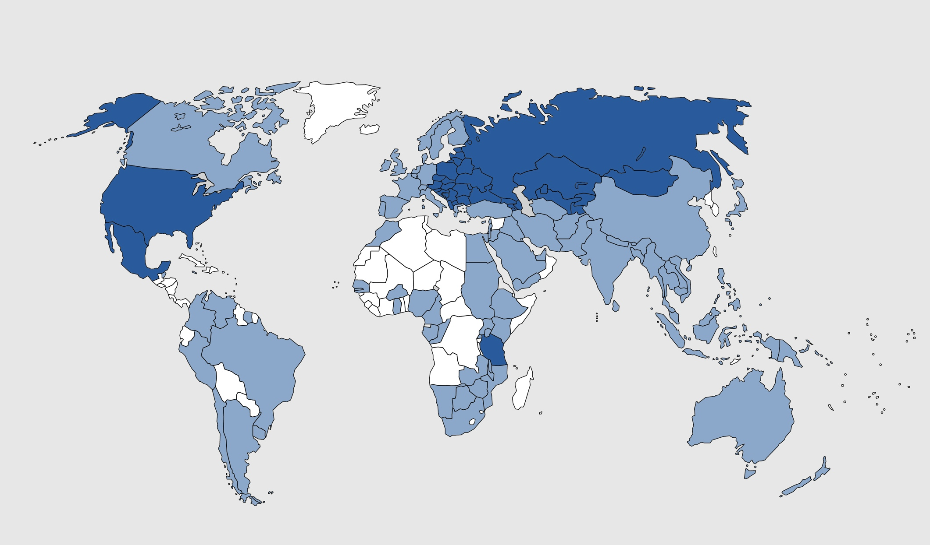
Global Penetration of the OMI, 1993–2015
Central &
Eastern Europe
12.211
Western Europe
554
South Caucasus & Central Asia
3.751
North & South America
333
Middle East
117
<100 Participants/ Country
Africa
286
Southeast Asia
& Oceania
117
>100 Participants/ Country
American Austrian Foundation © 2015

Slide 12
STEP 2
Step 2
Experience Exchange
OMI – Clinical Observerships
All Seminar Alumni are eligible for up to 3 x 1-month Clinical Observerships in Austrian and American Hospitals
Hands-on Training – Experience Exchange
New Techniques and Treatment Protocols
Build Cross-Border
Professional and Personal Relationships
Establish Joint Research
Projects and Collaborative Studies

Slide 13
STEP 2
OMI Observerships by Country, 1993–2015
Central &
Eastern Europe
Albania, Belarus, Bosnia Herzegovina, Bulgaria, Croatia, Czech Republic, Estonia, Hungary, Kosovo, Latvia, Lithuania, Macedonia, Moldova, Montenegro, Poland, Romania, Russia, Serbia, Slovakia, Slovenia, Ukraine
1.476
South Caucasus & Central Asia
668
Armenia, Azerbaijan, Georgia, Kazakhstan, Kyrgyzstan, Mongolia, Tajikistan, Uzbekistan
Africa
36
Congo, Ethiopia, Nigeria, Tanzania, Uganda
North & South America
4
Mexico
Southeast Asia
& Oceania
3
Afghanistan, Papua New Guinea
Middle East
3
Iraq
Western Europe
2
Spain, United Kingdom
Observers:
Countries: 40
Observership (months): 3.002
2.192
American Austrian Foundation © 2015

Slide 14
STEP 3
Capacity Building
OMI Symposia & Visiting Professorships
2–3 day In-Country Symposia or Visiting Professorships
Regional Faculty
Organized by
Local Fellow
International
Faculty
Reach a Larger Audience of Local Healthcare Professionals

Slide 15
STEP 3
Capacity Building
OMI Symposia, 2000–2015
Central &
Eastern Europe
122
Albania, Bulgaria, Croatia, Czech Republic, Estonia, Hungary, Kosovo, Latvia, Lithuania, Macedonia, Moldova, Montenegro, Poland, Romania, Russia, Serbia, Slovakia, Slovenia, Ukraine
South Caucasus & Central Asia
35
Armenia, Azerbaijan, Georgia, Kazakhstan, Kyrgyzstan, Mongolia, Uzbekistan
Western Europe
& Americas
9
Austria, Mexico
Middle East
2
Qatar
OMI Symposia:
Countries: 29
168
American Austrian Foundation © 2015

Slide 16
STEP 3
Capacity Building
Distance Learning
Video Conferences
OMI Handbook Online
Scientific Case Library
CHOP Open
Open Educational Resource
for Pediatricians worldwide offered by
The Children’s Hospital of Philadelphia and OMI
OMC
Open Medical Club
Local OMCs Represent & Promote
the OMI Programs in the Region
American Austrian Foundation © 2015

Slide 17
CAPACITY BUILDING – Virtuous Circle
FELLOW
3. OMI SYMPOSIA / VISITING PROFESSORSHIP
Capacity Building
1. MEDICAL SEMINARS
Knowledge Transfer
FACULTY
OBSERVER
2. OBSERVERSHIPS
Experience Exchange
American Austrian Foundation © 2015
Notes:
17

Slide 18
Three-Step Approach to Capacity Building
STEP 4
Medical Education
Medical Leadership
Medical Quality & Patient Safety
Applied Clinical Research
Clinical Informatics
Leadership
Program
Clinical Science
& Health Policy
STEP 3
Capacity
Building
Symposia, e-learning,
Open Medical Clubs
STEP 2
Experience
Exchange
Clinical and Research Observerships
STEP 1
Knowledge
Transfer
Salzburg Medical Seminars

Slide 19
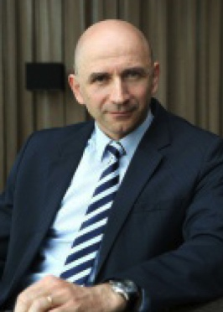
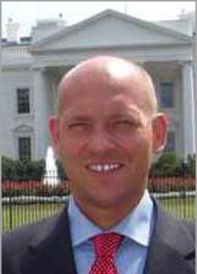
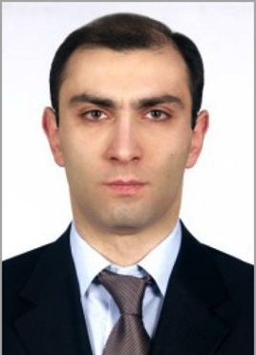
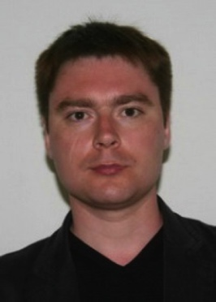
CAPACITY BUILDING – OMI Success Stories
Dr. Peter Krcho
Kosice, Slovakia
Established the first Neonatal Clinic & NICU in Slovakia.
Attended 8 OMI Seminars, 4 times faculty member
Dr. Ian Marounek
Czech Republic
Appointed Director of Healthcare at the Czech Ministry of Health.
Attended 1 OMI Seminar and 1 Observership
Dr. Artur Avetisyan
Armenia
Appointed Deputy Director of the National Centre of Oncology in Yerevan, Armenia, after participating in the Observership.
Attended 2 OMI Seminars and 1 Observership, Organized 2 in country Symposia
Dr. Sergey Chernov
Russia
Appointed Head of the Department of Neurooncology at the Novosibirsk Federal Centre of Neurosurgery after participating in the OMI Observership.
Attended 1 OMI Seminar and 2 Observerships
American Austrian Foundation © 2015
Notes:
19

Slide 20
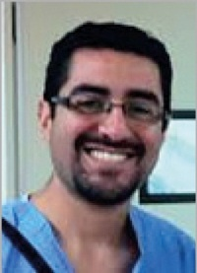
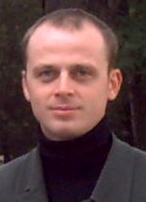
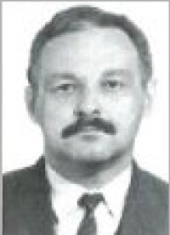
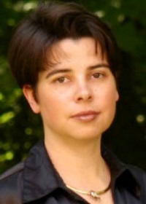
CAPACITY BUILDING – OMI Success Stories
Dr. Rodrigo Navarro Ramirez Mexico City, Mexico
Attended 1 OMI seminar and 1 Observership, Organized 1 Satellite Symposium
Is in regular contact with leading trauma surgeons about specific cases, many instances where US specialists’ input proved to be life saving for his patients.
Dr. Vladimir Kenis St. Petersburg, Russia
Head of Paediatric Orthopaedic Institute n. a. H. Turner.
Attended 3 OMI seminars, 3 Observerships
Organizes yearly Pediatric Orthopedic Symposia at his home institution. Presented clinical cases for discussion. 9 Publications in leading journals.
Dr. Alexandr Zagorulko
Simferopol, Ukraine
Attended 3 OMI seminars and 3 Observerships
Published the most up-to-date atlas for the lung’s microstructure, in collaboration with scientists from the University of Vienna.
Dr. Laura Krekulova Prague, Czech Republic
Attended 4 OMI Seminars, 2 time faculty member
Won a $ 250,000 NIH Fogarty Grant to fund her own lab in Prague to genotype Hepatitis C Viruses.
American Austrian Foundation © 2015
Notes:
20

Slide 21
CAPACITY BUILDING – OMI Program IMPACT
as %age of the National Physician Population
COUNTRY | FELLOWSHIPS AWARDED | TOTAL NUMBER OF PHYSICIANS | % OF TOTAL PHYSICIANS |  | COUNTRY | FELLOWSHIPS AWARDED | TOTAL NUMBER OF PHYSICIANS | % OF TOTAL PHYSICIANS
Montenegro | 186 | 1.251 | 14,87% |  | Georgia | 458 | 18.235 | 2,51%
Albania | 456 | 3.696 | 12,34% |  | Tajikistan | 258 | 13.247 | 1,95%
Armenia | 856 | 8.355 | 10,25% |  | Czech Republic | 710 | 38.171 | 1,86%
Estonia | 442 | 4.372 | 10,11% |  | Hungary | 518 | 29.500 | 1,76%
Macedonia | 418 | 5.364 | 7,79% |  | Bulgaria | 407 | 28.384 | 1,43%
Slovenia | 346 | 5.121 | 6,76% |  | Romania | 641 | 51.153 | 1,25%
Latvia | 380 | 6.456 | 5,89% |  | Azerbaijan | 403 | 32.335 | 1,25%
Tanzania* | 119 | 2.050 | 5,80% |  | Kazakhstan | 551 | 58.690 | 0,94%
Mongolia | 401 | 7.584 | 5,29% |  | Ukraine | 1.242 | 158.681 | 0,78%
Lithuania | 640 | 13.552 | 4,72% |  | Belarus | 259 | 35.904 | 0,72%
Moldova | 473 | 10.060 | 4,70% |  | Poland | 472 | 84.221 | 0,56%
Croatia | 574 | 12.490 | 4,60% |  | Uzbekistan | 374 | 66.856 | 0,56%
Bosnia Herzegovina | 298 | 6.664 | 4,47% |  | Austria | 172 | 40.634 | 0,42%
Slovakia | 647 | 16.201 | 3,99% |  | Russia | 1.788 | 614.183 | 0,29%
Kyrgyzstan | 337 | 10.698 | 3,15% |  | Mexico | 150 | 240.525 | 0,06%
Serbia | 640 | 20.825 | 3,07%
Source: http://apps.who.int/gho/data/node.main.A1443?lang=en
*http://www.aho.afro.who.int/profiles_information/images/c/c8/Tanzania-Statistical_Factsheet.pdf?ua=1&ua=1
American Austrian Foundation © 2015

Slide 22
CAPACITY BUILDING – Brain Gain
Country | Total | In CountrY |  | Abroad |  | Unknown & Attrition
 | n | n | % | n | % | n | %
Estonia | 377 | 370 | 98% | 5 | 1% | 2 | 1%
Latvia | 324 | 300 | 93% | 13 | 4% | 11 | 3%
Lithuania | 509 | 432 | 85% | 23 | 5% | 54 | 9%
Macedonia | 332 | 314 | 95% | 11 | 3% | 7 | 1%
Mongolia | 367 | 310 | 84% | 14 | 4% | 43 | 12%
Information source:
E-mails responded
Physicians’ Register
University Hospital Register
Google search

Slide 23
WHY IS OMI MORE SUCCESSFUL THAN OTHER PROGRAMS?
We believe in …
Short-term educational programs
Multiple opportunities to participate
Programs tailored to the needs of the participants
Ongoing contacts & communications after return
Peer to peer mentoring

Slide 24
Funding Partners
LEIR
FOUNDATION
OLGA HAVEL FOUNDATION
American Austrian Foundation © 2015

Slide 25
The Real Benefit
“This educational program not only changed my life,
it saved the lives of many of my newborn babies
who otherwise would not have had a chance.”
Dr. Peter Krcho, MD, PhD
Faculty member OMI Seminars
Head of the 1st Neonatal Clinic & Intensive Care Unit
Kosice, Slovakia
www.neonatology.sk
American Austrian Foundation © 2015
Notes:
25

Slide 26
Contact Information
New York
The American Austrian Foundation
c/o UniCredit Group
150 East 42nd Street, 28th fl.
New York, NY 10017 (USA)
Tel: +1-212-856-1075
ny.office@americanaustrianfoundation.org
Salzburg
Salzburg Stiftung der
American Austrian Foundation
Schloss Arenberg
Arenbergstrasse 10
5020 Salzburg (Austria)
Tel: +43-662-640-101
salzburg.office@americanaustrianfoundation.org
Vienna
Verein der Freunde der
American Austrian Foundation
Palais Todesco
Kärntner Str. 51 /II/ Top 4
A-1010 Vienna (Austria)
Tel: +43-1-533 8658
vienna.office@americanaustrianfoundation.org
www.aaf-online.org
American Austrian Foundation © 2015
Notes:
26

