Slide 1
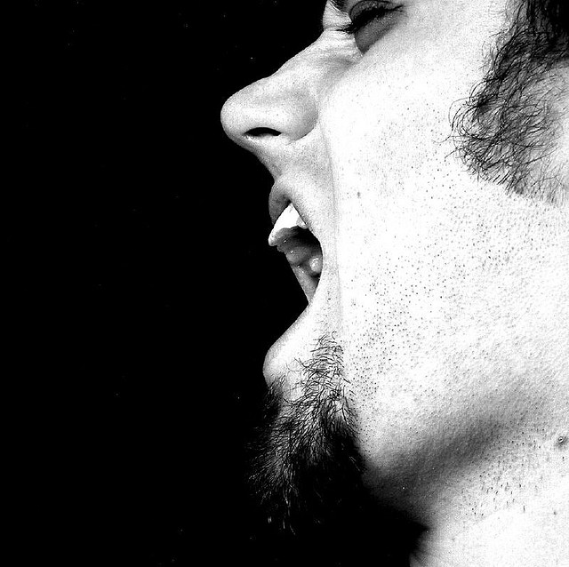
5
Steps to Promotion Strategy
Mary Joyce for the Open Society Foundations | Istanbul, 2011
Images: altemark and no prawns/Flickr

Slide 2
The 5 Steps
1:Define Goal
2:Define Audience
3:Find Partners
4:Determine Media
5:Select Actions

Slide 3
Define Goals
What is the most important PG promotion goal for your organization?

Slide 4
Examples
Goals:

Slide 5
Examples
Goals: trainings : PG : patient-friendly

Slide 6
Define Audience
What audience do you need to reach to achieve that goal?

Slide 7
Examples
Goals: trainings : PG : patient-friendly
Audiences:

Slide 8
Examples
Goals: trainings : PG : patient-friendly
Audiences: lawyers : doctors : patients?

Slide 9
Examples
Goals: trainings : downloads : patient-friendly
Audiences: lawyers : doctors : patient groups

Slide 10
Find Allies
Don’t go it alone. Who do you know that can help you reach your audiences?

Slide 11
make new partners
Start with audience, then decide what partners you need
Images: altemark and no prawns/Flickr

Slide 12
Examples
Goals: trainings : PG : patient-friendly
Audiences: lawyers : doctors : patient groups
Partners:

Slide 13
Examples
Goals: trainings : PG : patient-friendly
Audiences: lawyers : doctors : patient groups
Partners: professional organizations : NGOs : working group members : journalists

Slide 14
Determine Media
How will these allies help you reach your audience?

Slide 15
Determine Media
What media for:
IDU?
Palliative
Care?
HIV/AIDS?
Sex Worker?
General Patient?
audience’s ATTENTION
partner’s
ACCESS
media

Slide 16
Examples
Goals: trainings : PG : patient-friendly
Audiences: lawyers : doctors : patient groups
Partners: professional organizations : NGOs : working group members : journalists
Media:

Slide 17
Examples
Goals: trainings : PG : patient-friendly
Audiences: lawyers : doctors : patient groups
Partners: professional organizations : NGOs : working group members : journalists
Media: publications : NGO web sites and offices : flyers in hospitals : radio

Slide 18
Select Actions
Goals: trainings : PG : patient-friendly
Audiences: lawyers : doctors : patient groups
Partners: professional organizations : NGOs : working group members : journalists
Media: publications : NGO web sites and offices : flyers in hospitals : radio
Action Plan: bulleted list : detailed report

Slide 19
With so many options, where do you start?
Select Actions

Slide 20
With so many options, where do you start?
Select Actions
Goals:
Audiences:
Partners:
Media:
Plan:

Slide 21
With so many options, where do you start?
Select Actions
Goals: Pick soonest or hardest
Audiences:
Partners :
Media:
Plan:

Slide 22
With so many options, where do you start?
Select Actions
Goals: Pick soonest or hardest
Audiences: Pick most critical
Partners :
Media:
Plan:

Slide 23
With so many options, where do you start?
Select Actions
Goals: Pick soonest or hardest
Audiences: Pick most critical
Partners : Pick partner with best contact with your audience and closest relationship to you
Media:
Plan:

Slide 24
With so many options, where do you start?
Select Actions
Goals: Pick soonest or hardest
Audiences: Pick most critical
Partners : Pick partner with best contact with your audience and closest relationship to you
Media: Which media does your ally have access to? Is this a media that the audience also pays attention to?
Plan:

Slide 25
With so many options, where do you start?
Select Actions
Goals: Pick soonest or hardest
Audiences: Pick most critical
Partners : Pick partner with best contact with your audience and closest relationship to you
Media: Which media does your ally have access to? Is this a media that the audience also pays attention to?
Plan: Let’s do that now…

Slide 26
Write a simple promotion action plan using this model:
Action Plan
j Goal
j Audience
j Partner : to help you reach audience
k or l Media Types: partner access + audience attention
l Deadlines:
partner contact
message development
publication

Slide 27
Let’s Share
Thank you for your attention.
Images: altemark and no prawns/Flickr

